Slide 1
NZZO AIDC
APAC/NAT AIDC TF/2
Bangkok 22-26 July 2013

Slide 2
NZZO (Auckland OCA)
Oakland
Fiji
Tahiti
Brisbane
Melbourne
NZZO
Santiago
Notes:
NZZO 30,000,000 KM – Adjacent FIR Melbourne YMMM, Brisbane YBBB, Fiji NFFF, Oakland KZOA, Tahiti NTTT, Santiago SCEL and New Zealand Domestic NZZC

Slide 3
Domestic ATM - NZZC
Two Domestic ATC Centres – Christchurch (3 Terminal sectors 6 Area Sectors + Auckland (1 Area Sector)
Skyline ATM System (Lockheed Martin)
Installed 2002
Surveillance
PSR
SSR
Multilateration
ADS-B
AIDC interface with NZZO Auckland Oceanic

Slide 4
Oceanic ATM - NZZO
Installed 2000
Procedural System
FANS1/A integrated FDP
Conflict Probe
Electronic Strips
RNP10 50/50 separation
RNP4 30/30 separation
Similar to FAA Oceanic Systems, Santa Maria, Nadi, and Iceland ATM systems.
AFTN AIDC interface with NZZC, YBBB, YMMM, NFFF, NTTT, KZAK per ASIA/PAC ICD.
“Psuedo” AIDC with Santiago, Tonga, Rarotonga, Samoa
Auckland Oceanic Centre
ATM – Oceanic Control System (OCS)

Slide 5
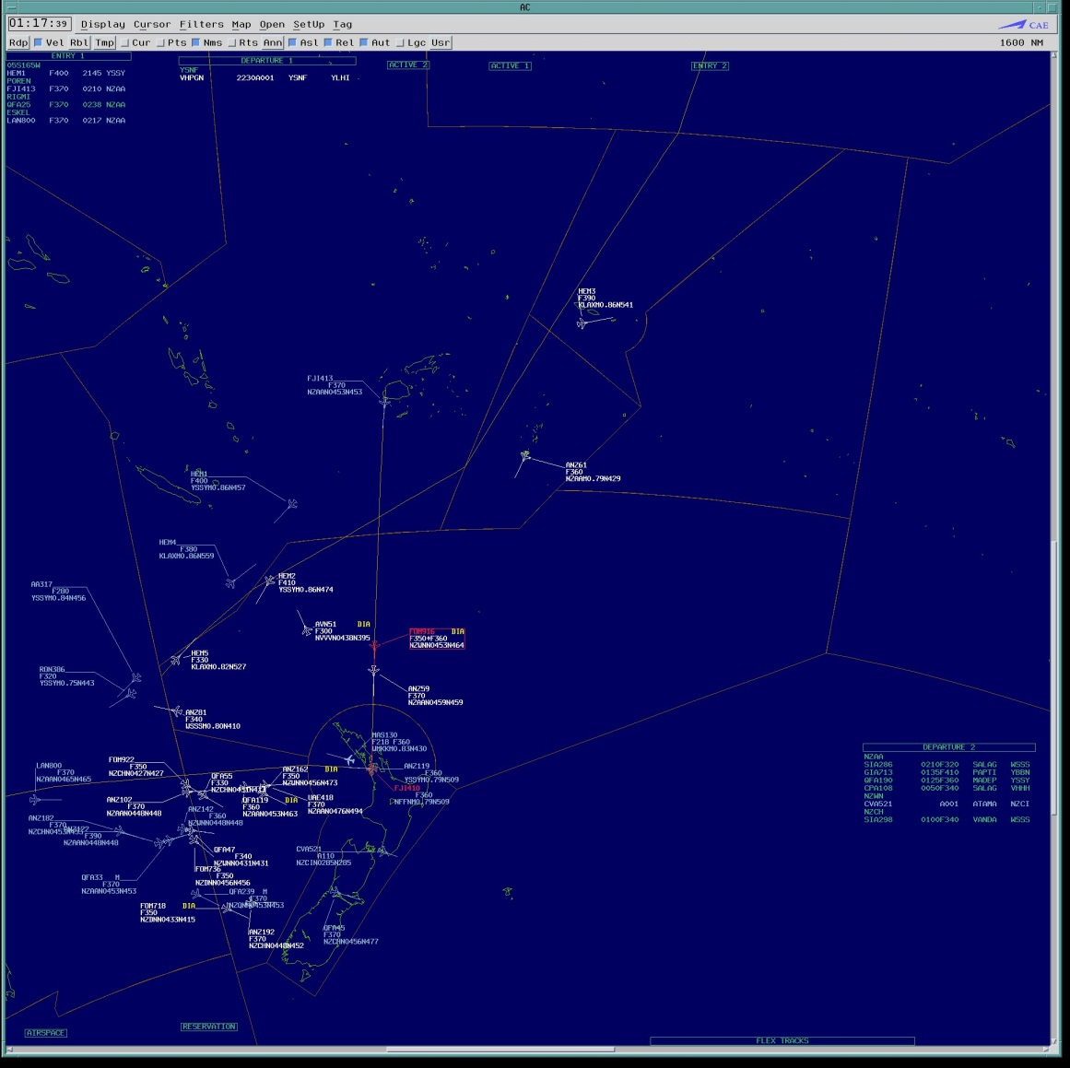
Oceanic ATM - NZZO
2 Screens (Air Situation Display + Display Interface)
2K Barco – replaced with 30 inch LCD October 2012
Airways manages own software and hardware upgrades
2nd Hardware refresh installed October 2012
Airways schedules 4 software upgrades per year

Slide 6
NZZO Oceanic ATM – AIDC Benefits
The ICAO Global Plan notes that AIDC brings significant advantages over voice communication in terms of both workload and safety.
The plan notes that the automation of coordination tasks using AIDC between adjacent sectors improves the quality of information on traffic transiting between sectors and makes it more predictable, thereby allowing reduced separation minima, decreased workload, increased capacity, more efficient flight operations, and enhanced safety.
This has certainly been the NZZO experience.

Slide 7
NZZO Oceanic ATM – AIDC Benefits
In NZZO AIDC was implemented with the OCS ATM system in 2000.
At that time we were struggling to maintain a procedural paper strip based system using a single oceanic sector operation with an average of around 130 flights per day.
With OCS and AIDC we are now handling an average of 200 flights per day and still maintaining a single sector operation.
There has been a significant reduction in controller loop errors and a significant reduction in controller workload by automating the coordination tasks using AIDC.

Slide 8
NZZO Oceanic ATM – AIDC Benefits
DARP (Dynamic Airborne Reroute Procedure) has the aircraft making reroute requests directly to the ATC unit in control who then process and modify the request if necessary and forward the approved route to aircraft and the next downstream ATC unit.
AIDC is a pre-requisite before implementing the DARP procedure.
We have implemented DARP for aircraft in transit between Auckland, Nadi, Tahiti, and Oakland FIR.
AIDC has assisted Airways New Zealand providing our customers the benefits envisaged in the Global Plan.

Slide 9
NZZO Oceanic ATM – AIDC Benefits
Typical early morning traffic pattern in NZZO at 0400AM.
All FANS1/A data-link aircraft (solid APS symbol) are flying UPR routes between NAM and Australia/New Zealand.
Two of the southbound aircraft have carried out DARP procedure in Oakland airspace with the revised route passed by AIDC.
Note traffic flow aligned with NFFF/NZZO boundary, we see numerous “Short Sector” transits with increased coordination requirements assisted by AIDC

Slide 10
AIDC – In SOPAC via AFTN
Airways upgraded to a Comsoft AFTN/AMHS switch in March 2012.
International AFTN circuits are still via X25.
Intention is to upgrade international circuits to TCP/IP.
All AIDC currently via AFTN but intention is to move to AMHS.
Representative AIDC messages received per month and latency
66726 AIDC messages were received in the month illustrated with 99.9% received within 20 seconds.
Of 35717 messages with LAM response 1 LAM exceeded accountability timer of 180 seconds
 | ABI | CPL | CDN | EST | ACP | TOC/AOC
Average | 3.5" | 2.5" | 2" | 2" | 2" | 1.5"
Min | 2" | 1" | 1" | 1" | 1" | 1"
Total # | 4216 | 3420 | 5003 | 2095 | 5988 | 10123

Slide 11
AIDC – NZZO Daily AIDC Traffic
Typical numbers of AIDC and FPL messages per day (13/9/13)
Message | ABI | CPL | CDN | EST | ACP | TOC
Total # | 606 | 233 | 198 | 122 | 551 | 310
Message | AOC | PAC | LAM | LRM | AOC
Total # | 305 | 35 | 2262 | 10 | 305
Message | FPL | CHG | DLA | DEP | ARR
Total # | 188 | 10 | 20 | 272 | 75

Slide 12
AIDC Interface Differences NZZO and..
OCS allows the specification of individual message sets per FIR and the parameters to be used with each set in adaptation.
The adaptation data for each FIR includes:
the type of messages to be used e.g. CPL or EST;
the fields to be used in each message;
the timing of messages;
Route detail to be sent in Field Type15. Some FIR require the Field type 15 route to start at the waypoint preceding the coordination point while others expect the full FPL route to be included;
The different Field type 14 optional subfields used by each FIR (block level, speed, weather deviation/offset).
Notes:
SCIZ – NZZO send ABI and EST to Santiago from the OCS system, Santiago send EST to NZZO.

Slide 13
AIDC Interface Differences NZZO and..
 | YBBB | YMMM | NFFF | NTTT | KZOA | NZZC
Notify | ABI | ABI | ABI | ABI | ABI | ABI
Coordinate Initial | EST | Voice | CPL | CPL | CPL | CPL
Coordinate Negotiate | CDN | Voice | CDN | CDN | CDN | CDN
Item 14 - Block Level | YES | YES | YES | YES | YES | YES
Item 14 – Weather Deviation/Offset | NO | NO | YES | YES | YES | YES
Item 14 - Speed | NO | NO | YES | YES | YES | NO
Notify Time | 40’ | 40’ | 40’ | 60’ | 70’ | 120’
Coordinate Initial Time | 30’ | 30’ | 30’ | 30’ | 30’ | 30’
Field 15 Route type | ALL | ALL | ALL | ALL | PRE-COP | PRE-COP
Notes:
SCIZ – NZZO send ABI and EST to Santiago from the OCS system, Santiago send EST to NZZO.

Slide 14
“Pseudo” AIDC Interface.
Use simple AFTN messages created by templates at SCIZ, NCRG, NFTF, and NSFA
No Header Information/CRC
Pragmatic method to overcome difficulties with poor telephone connectivity between stations.
 | NCRG | NFTF | NSFA | SCIZ
Notify | NO | NO | NO | ABI
Coordinate Initial | PAC | PAC | PAC | EST
Coordinate Negotiate | CDN | CDN | CDN | Voice
Item 14 - Block Level | YES | YES | YES | YES
Item 14 – Weather Deviation/Offset | YES | YES | YES | YES
Item 14 - Speed | NO | NO | NO | NO
Notes:
SCIZ – NZZO send ABI and EST to Santiago from the OCS system, Santiago send EST to NZZO.

Slide 15
“Pseudo” AIDC Interface.
NFTF, NCRG, NSFA – Pacific Island States. Coordination for flights departing and climbing directly into NZZO airspace above F250. We use PAC/CDN for co-ordination of flights departing from NFTF,NCRG,NSFA. e.g.
KIA0710 130228
FF NZZOZQZF
130226 NSFAZTZX
(PAC-MGE705-NSTU-LAKER/0239F370F030A-PHNL)
IKA0619
FF NSFAZTZX
130229 NZZOZQZF
(ACP-MGE705-NSTU-PHNL)
KIA0712 130229
FF NZZOZQZF
130227 NSFAZTZX
(CDN-MGE705-NSTU-PHNL-14/LAKER/0239F370F030A)
IKA0622
FF NSFAZTZX
130231 NZZOZQZF
(ACP-MGE705-NSTU-PHNL)
Notes:
SCIZ – NZZO send ABI and EST to Santiago from the OCS system, Santiago send EST to NZZO.

Slide 16
“Pseudo” AIDC Interface.
With Santiago we use EST/ACP exchanges for co-ordination e.g.
KIA2468 131011
FF NZZOZQZF
131011 SCELZOZY
(EST-LAN801/A5370-SCEL-48S131W/1113F280F360-NZAA
IKA2273
FF SCELZOZX
131012 NZZOZQZF
(ACPNZZO/SCEL290-LAN801/A5370-SCEL-NZAA)
Notes:
SCIZ – NZZO send ABI and EST to Santiago from the OCS system, Santiago send EST to NZZO.

Slide 17
AIDC Interface – NZZC Domestic
With our domestic airspace (Lockheed Martin Skyline ATM) we use for departing flights into NZZO a CPL-ACP-CDN-ACP-TOC-AOC exchange
KCA1854
FF NZZOZQZF
130648 NZZCZQZX 2.058387-4.130713064834-5.6F28-
(CPL-CAL052/A0262-IS
-A333/H-SDE1E2E3FGHIJ3J5M1RWY/LB1D1
-NZAA-MADEP/0716F320
-N0454F320 MADEP/N0465F360 N774 MARLN DCT
-YSSY
-PBN/A1B1C1D1O1S2 DOF/130713 REG/B18312 EET/NZZO0030 YBBB0120
YMMM0239 SEL/MSHR CODE/8991BA ORGN/RCTPCALC PER/C RALT/NZAA YSSY
RMK/ADSB AUSEP TCAS EQUIPPED TEL 88633981451)
Note: AUTO ACP
IKA1604
FF NZZCZQZX
130649 NZZOZQZF 2.000841-3.NZZC058387-4.130713064836-5.6688-
(ACP-CAL052/A0262-NZAA-YSSY)
Notes:
SCIZ – NZZO send ABI and EST to Santiago from the OCS system, Santiago send EST to NZZO.

Slide 18
AIDC Interface – NZZC Domestic (2)
With our domestic airspace (Lockheed Martin Skyline ATM) we use for departing flights into NZZO a CPL-ACP-CDN-ACP-TOC-AOC exchange
FF NZZOZQZF
130650 NZZCZQZX 2.058390-4.130713065034-5.3DCD-
(CDN-CAL052/A0262-NZAA-YSSY
-14/MADEP/0717F320-15/N0454F320 MADEP/N0465F360 N774 MARLN DCT
-18/PBN/A1B1C1D1O1S2 DOF/130713 REG/B18312 EET/NZZO0030 YBBB0120
YMMM0239 SEL/MSHR CODE/8991BA ORGN/RCTPCALC PER/C RALT/NZAA YSSY
RMK/ADSB AUSEP TCAS EQUIPPED TEL 88633981451)
Note: AUTO ACP
IKA1611
FF NZZCZQZX
130651 NZZOZQZF 2.000844-3.NZZC058390-4.130713065036-5.6688-
(ACP-CAL052/A0262-NZAA-YSSY)
Notes:
SCIZ – NZZO send ABI and EST to Santiago from the OCS system, Santiago send EST to NZZO.

Slide 19
AIDC Interface – CDN exchange (1)
BAA2915 130849
FF NZZOZQZF
130849 NFFFZQZF 2.000581-4.130713084925-5.D357-
(CPL-UAL870/A1504-IS
-B744/H-SDE3FGHIJ5M1RWXYZ/LB1D1
-YSSY-SOVRA/0932F320F350
-M087F320 3347S15111E 3343S15132E DCT LHI B450 TUT B577 AHNDO A220
CINNY DCT OSI DCT
-KSFO
-PBN/A1B1C1D1L1O1S2 NAV/RNVD1E2A1 REG/N121UA EET/YBBB0014 NZZO0119
SEL/BQPS CODE/A0592C OPR/UAL PER/D RALT/PHTO KVBG RMK/TCAS)
Note: AUTO ACP
IKA1975
FF NFFFZQZF
130849 NZZOZQZF 2.000822-3.NFFF000581-4.130713084928-5.BE44-
(ACP-UAL870/A1504-YSSY-KSFO)
Notes:
SCIZ – NZZO send ABI and EST to Santiago from the OCS system, Santiago send EST to NZZO.

Slide 20
AIDC Interface – CDN exchange (2)
BAA3104 130927
FF NZZOZQZF
130928 NFFFZQZF 2.000601-4.130713092753-5.3D9D-
(CDN-UAL870/A1504-YSSY
-KSFO
-14/SOVRA/0932F320F350/W30R
-15/M087F320 3347S15111E 3343S15132E DCT LHI B450 TUT B577 AHNDO
A220 CINNY DCT OSI DCT)
Note: Not Auto ACP
IKA2109
FF NFFFZQZF
130930 NZZOZQZF 2.000841-3.NFFF000601-4.130713092938-5.BE44-
(ACP-UAL870/A1504-YSSY-KSFO)
Notes:
SCIZ – NZZO send ABI and EST to Santiago from the OCS system, Santiago send EST to NZZO.

Slide 21
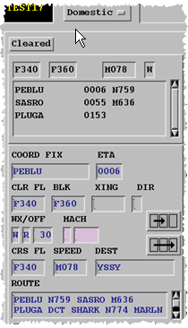
NZZO – OCS Coordination HMI (1)
Coordinated Fix PEBLU/0006
Coordinated Block F340F360
Pink background indicates Mach Speed coordination is not available with this sector
Coordinated Weather Deviation (W)
Up to 30NM Right (R 30)

Slide 22
NZZO – OCS Coordination HMI (2)

Slide 23
NZZO – CDN receipt
CDN Message – proposing a change in coordination is received from Nadi (NFFF) and processed from controllers queue.
The Coordination window opens with proposed data prefilled and changes from current coordination highlighted.
(CDN-ANZ819/A4425-NFFN
-NZWN
-14/POREN/0008F350F370/W20E
-15/M078F350 DCT AGTOS A578 KALAG A578 AA H384 KARRL Y506 PADMU Y738 WN DCT)
Notes:
Proposed data that is different from the current coordinated profile is highlighted to the controller using black background. In this example the aircraft was originally coordinated at F350 and was climbing above F280. The proposed coordination is in the block F350F370 with a weather deviation up to 20NM either side of track.

Slide 24
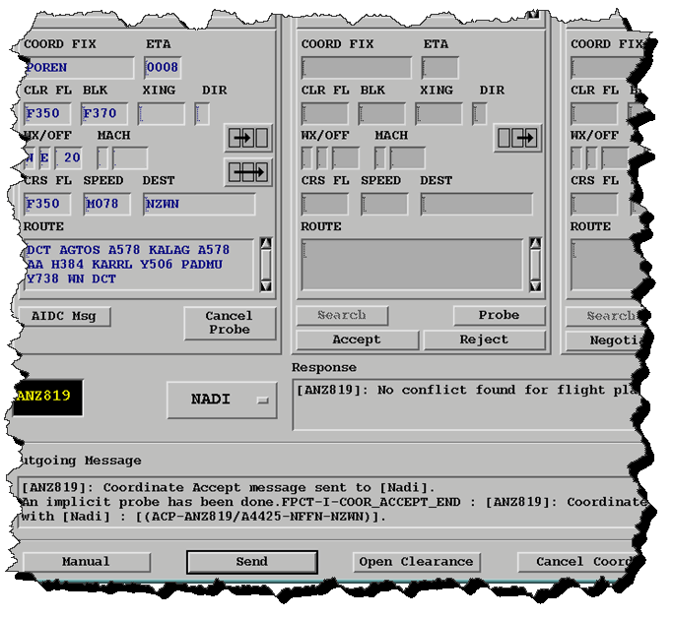
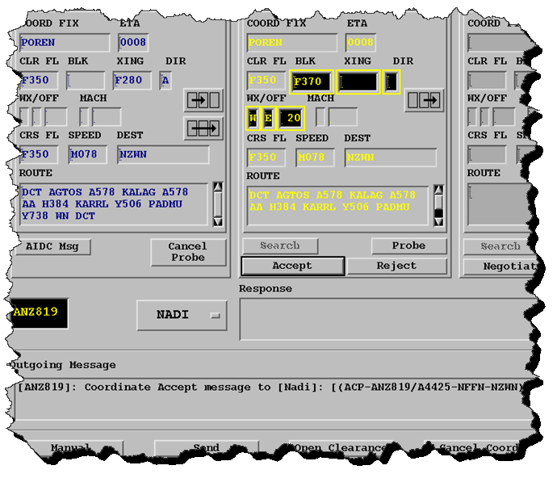
NZZO –– Process CDN
3. Accept – construct ACP message
Probe – for conflict
Response – no conflict found
4. Send – send ACP message
(ACP-ANZ819/A4425-NFFN-NZWN)

Slide 25
Coordination – Processing
The CDN processing depicted in the previous two slides occurred on 4 September 2012. The timing of the AIDC exchange was as follows:
2339:42 Nadi send AIDC CDN message
2339:44 CDN message received in the controllers queue.
2340:16 CDN message processed from queue.
2340:20 Proposed coordination probed for conflict.
2340:24 ACP message sent to Nadi.
2340:26 ACP message received in Nadi
2340:28 LAM response received from Nadi
44 seconds for Nadi controller to complete co-ordination
8 seconds for Auckland controller to process co-ordination

Slide 26
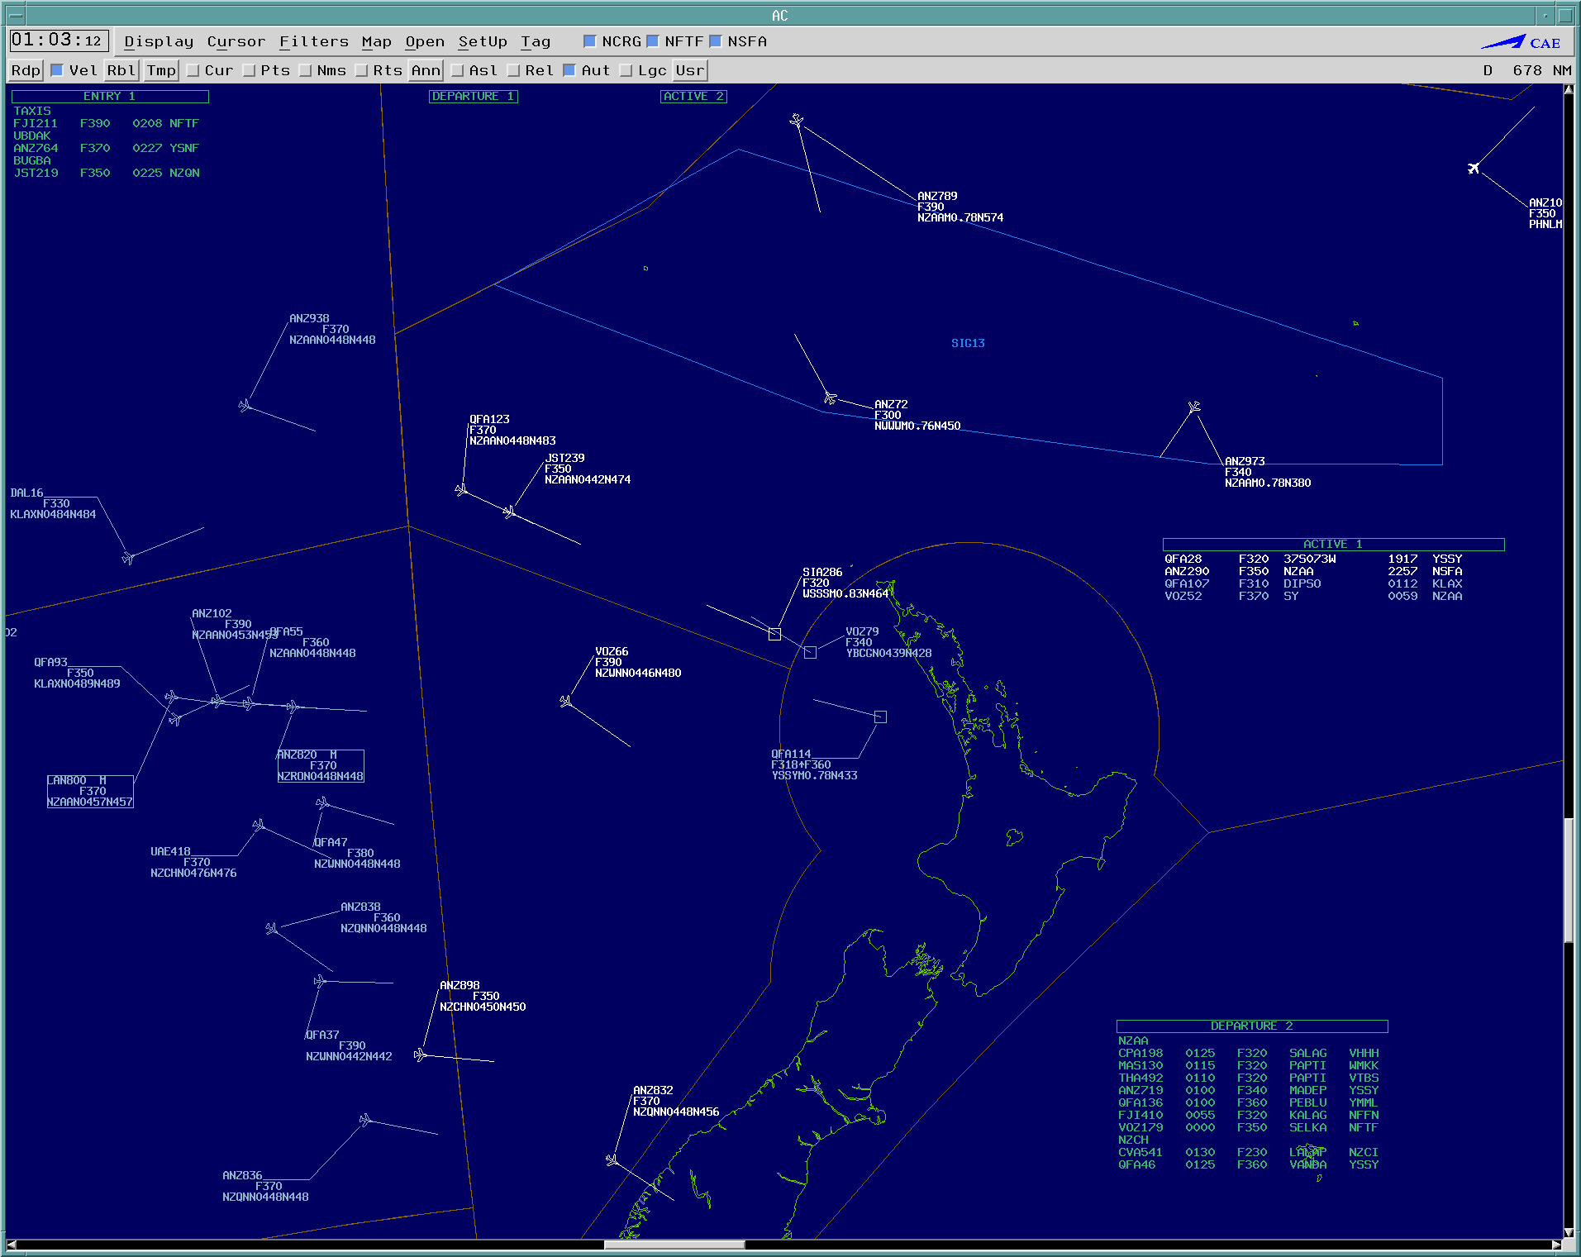
NZZO – YBBB – AIDC exchange (1)
LAN 800

Slide 27
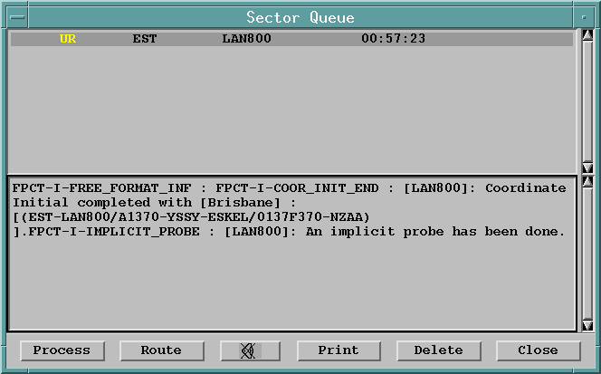
NZZO – YBBB – AIDC exchange (2)
Controller indications : this message in operational queue + visual indication on situation display

Slide 28
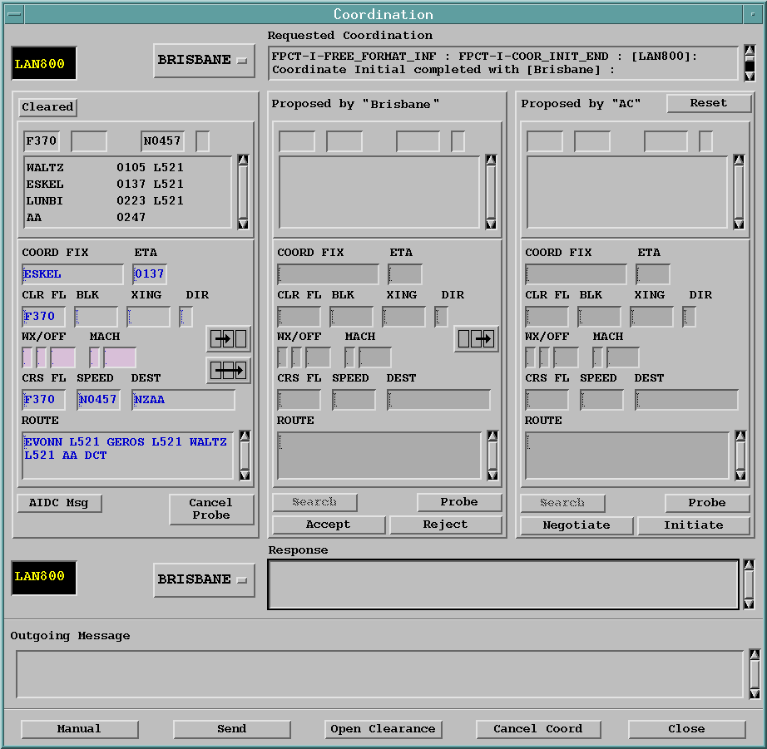
NZZO – YBBB – AIDC exchange (3)
Coordinated data

Slide 29
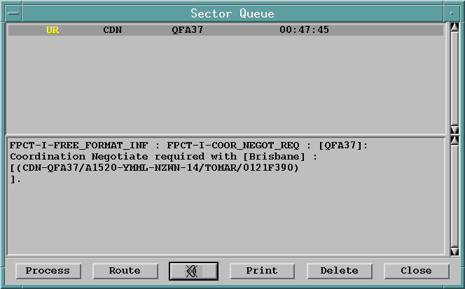
NZZO – YBBB – AIDC exchange (4)
Controller indications : this message in operational queue + visual indication on situation display

Slide 30
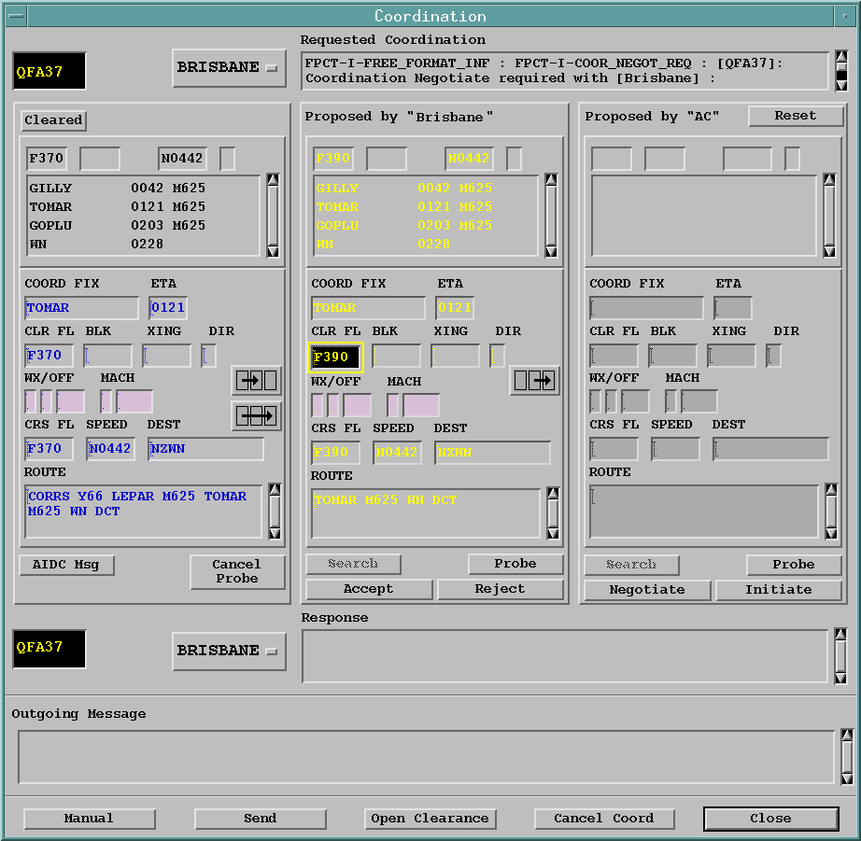
NZZO – YBBB – AIDC exchange (5)
Proposed Data
(Changes are highlighted)
Current coordinated data

Slide 31
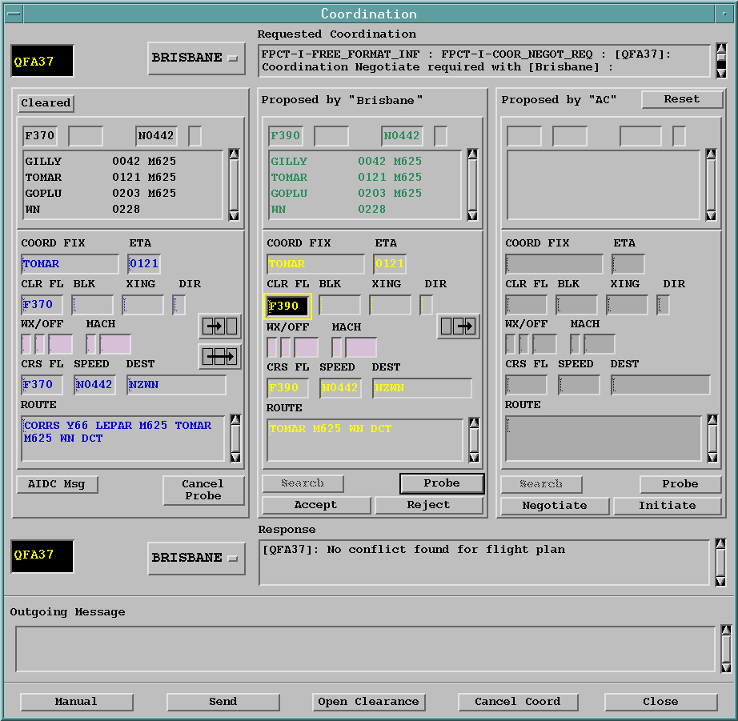
NZZO – YBBB – AIDC exchange (6)
Controller probes for conflict on proposed level change
No conflict reported

Slide 32
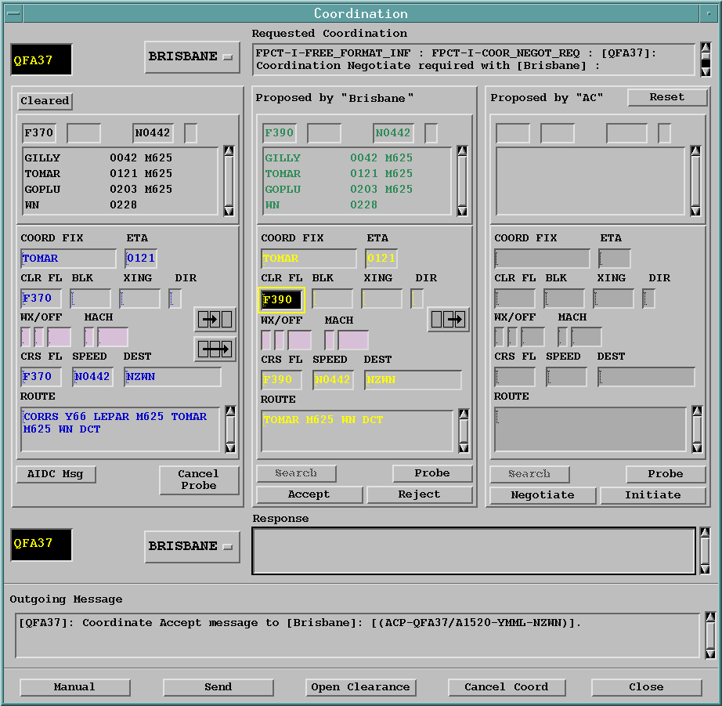
NZZO – YBBB – AIDC exchange (7)
Controller accepts revised coordination

Slide 33
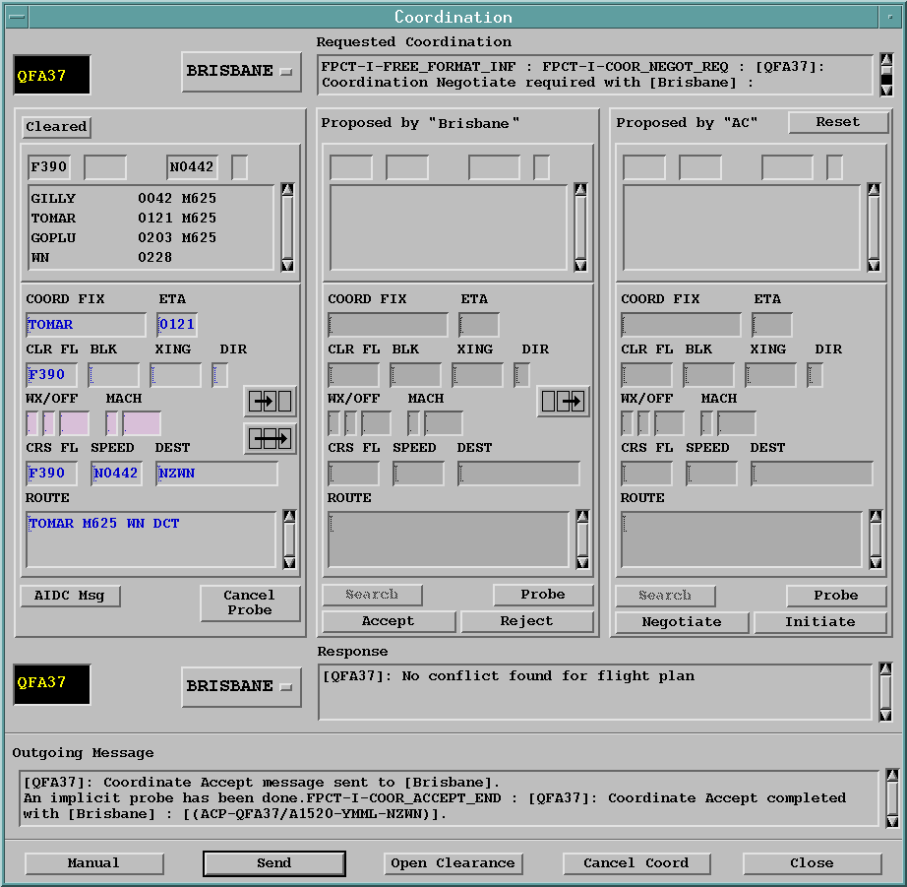
NZZO – YBBB – AIDC exchange (8)
Controller sends ACP

Slide 34
NZZO – AIDC Interface testing
Airways has a number of OCS platforms separate from the Operational Main and Reserve platforms, that we use for training, software development, and contingency operations.
We have the ability to setup one of these platforms with its own AFTN connection and distinct AFTN address to enable it to be used for full AIDC testing with other units.
This AIDC test platform was successfully used for the pre-implementation testing of the new TIARE ATM system in Tahiti in 2008 and 2009, and for the pre-implementation testing of the new Aurora ATM system in Fiji in early 2010.
More recently it has been used for ICAO 2012 FPL AIDC interoperability testing with the FAA, Tahiti, and Australia.
Testing being scheduled with Santiago for new AIDC capable ATM system

Slide 35
NZZO – AIDC issues
Incorrect route truncation. The Asia/Pacific ICD clearly states the rules required for truncating a route after the last known significant route point. If these rules are not followed there are significant risks associated with the transmission of incorrect route information to the downstream ATC unit. While the majority of instances investigated in New Zealand are the result of human error there have been occasions when the automation system was at fault. With the increasing use of DARP procedures and route modifications the accuracy of route handling and transmission between automated systems is of increasing importance. We have found that comprehensive training backed up by regular refresher training is required to minimize these errors.

Slide 36
NZZO – AIDC Issues
Handling duplicate fix/airway information. A lot of the route processing errors we see are caused by duplicated fix or airway names. The OCS ATM system can handle duplicate fixes in most cases because it uses both the fix name and associated FIR key as the key ie. AA NZZC, AA NFFF, AA NTTT. However, because we do not operate a global data base we do strike problems where a duplicate fix name is used as the entry point to an airway. If the duplicate fix name is known in adaptation but the airway is not the route extraction will fail requiring manual intervention. In the days when most flights flew fixed routes this was not such an issue. However, with the increasing use of UPR routes we are finding we have to spend more time on database management to keep this type of error at a minimum.

Slide 37
NZZO – AIDC issues
Conformance monitoring by the ATM automation. Mitigating route inaccuracy caused by failures in route truncation requires ground automation conformance monitoring of received position reports against the current flight plan.
This conformance checking in the Airways OCS ground system will check the reported current, next, and next+1 positions against current flight plan.
Conformance monitoring also provides mitigation for flight plan input errors in the aircraft FMS.

Slide 38
NZZO – AIDC issues
ATM system software coding differences. Different ground systems often come up with different interpretations of the same AIDC specification.
We have seen a number of different interpretations since implementing AIDC which we have had to work around.
While the interoperability testing and software development associated with the introduction of the ICAO 2012 FPL changes have been able to eliminate most coding differences we expect to see some more examples introduced as we move into the full use of the ICAO 2012 Flight Plan.
With Global ICD – the work is a good opportunity to clarify implementation requirements in the ICD and minimise interpretation issues.

Slide 39
Supplementary Slides

Slide 40
Thank you Paul Radford Oceanic Systems Manager Airways New Zealand paul.radford@airways.co.nz

